Slide 1
Pattern Recognition for Interpretable BCI
2017.06.14
Geun-Ho Choi O-Yeon Kwon

Slide 2
Contents
1. Introduction
Goal
Concept of Brain Computer Interface (BCI)
2. Methods
1. Conventional framework
2. Deep learning framework
3. Results and discussion
4. Conclusion

Slide 3
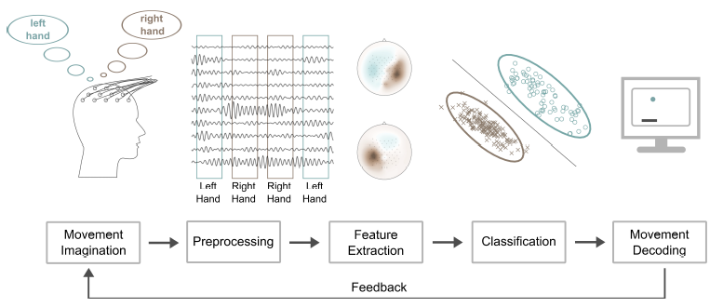
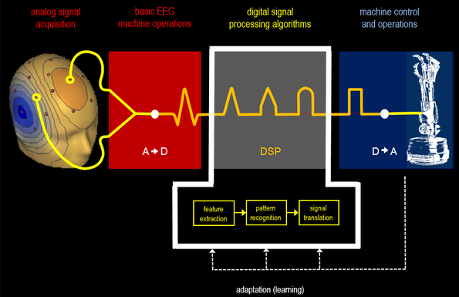
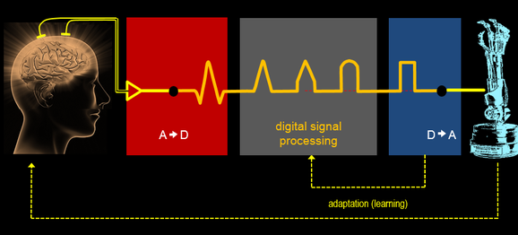
Introduction
Goal
Use pattern recognition methods and build extensive knowledge in the field of pattern recognition
Obtain a high classification accuracy in the filed of Brain computer inter face (BCI) by using a novel method
Motivation
Focusing on the recognition of patterns and regularities for the interpretation of data
BCI classification pipeline [Samek, 2014]

Slide 4
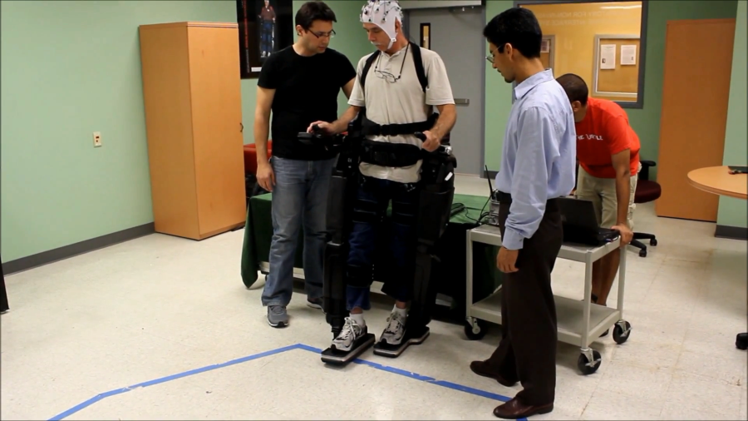
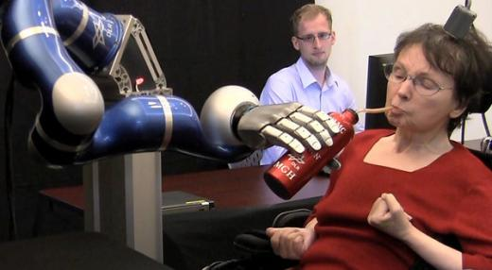
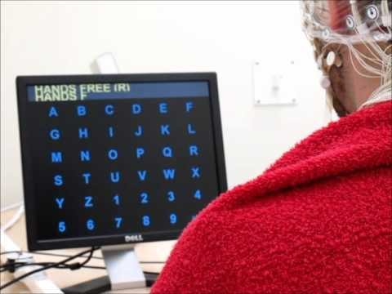
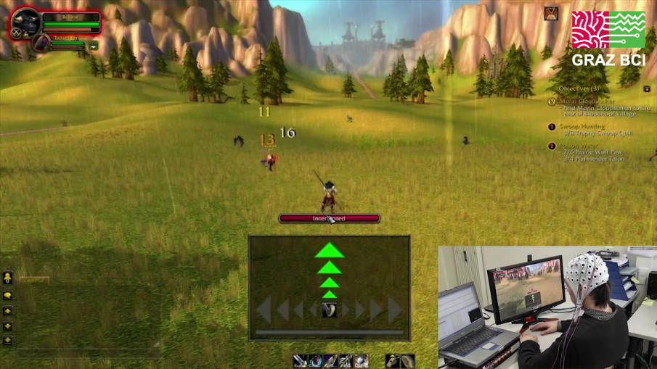
Brain Computer Interface (BCI) (1/2)
Definition
BCI is a direct communication pathway between an enhanced or wired brain and an external device [Wikipedia]
Application
Focusing on neuroprosthetics applications that aim at restoring damaged hearing, sight and movement
Brain computer interfaces have been used for a much broader variety of applications
Neuroprosthetics
Applications

Slide 5
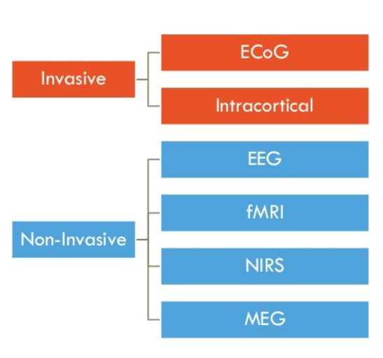
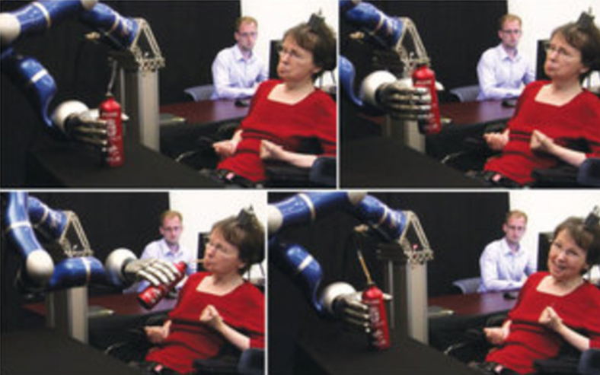
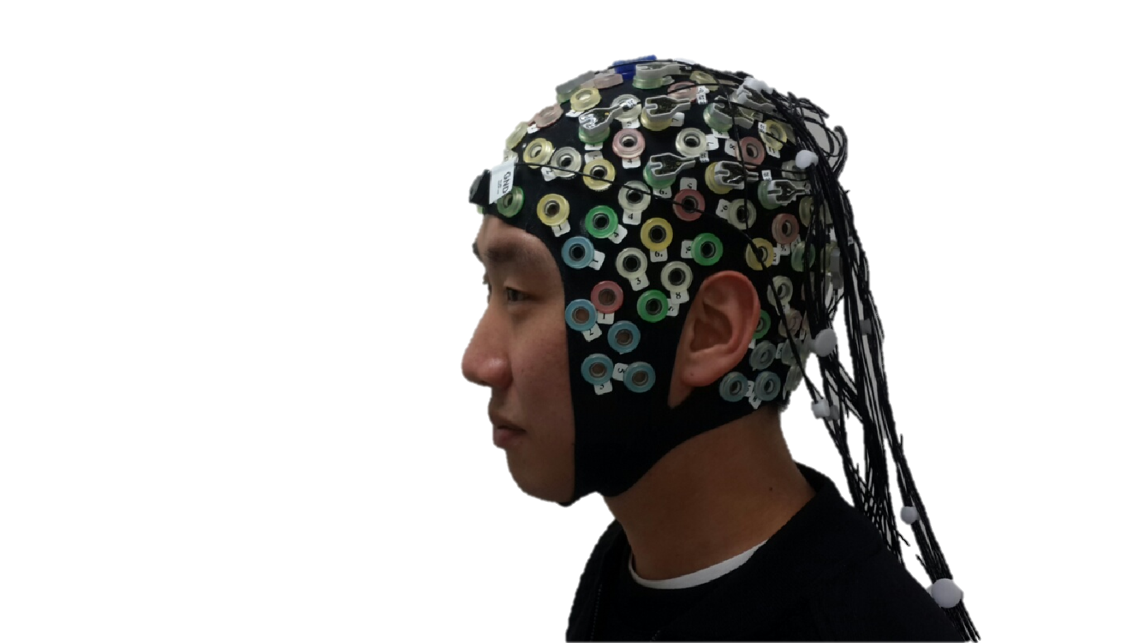
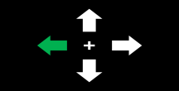
Brain Computer Interface (2/2)
Electroencephalography (EEG)
An electrophysiological monitoring method to record electrical activity of the brain - Wikipedia
Motor Imagery (MI)
A mental process by which an individual rehearses or simulates a given action – Wikipedia
e.g., left hand or right hand movement imagination
Motor Imagery
SSVEP
P300
Different approaches of BCI
EEG measurement and MI task
Thought Control [Nature, 2012]

Slide 6
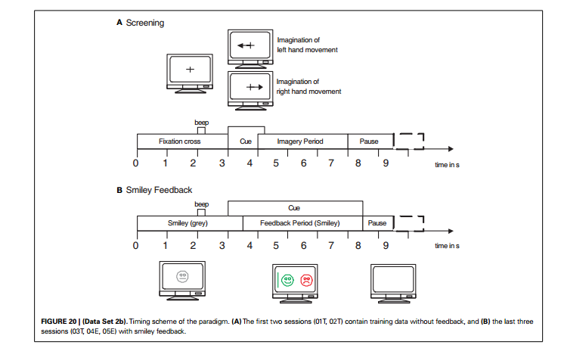
Methods (1/3)
Dataset
Description
BBCI_IV Data Set 2b
9 subjects (C3, Cz, C4 channels)
Paradigm
Motor Imagery
Subjects were instructed with a text on the monitor to perform either up-down or left-right movements
Data analysis
1. Pre-processing
Band-pass-filter (8-30 Hz)
Segmentation (4s - 7s)
2. Feature extraction
1. Log-variance
2. Common Spatial Pattern (CSP)
3. Classification
Linear Discriminant Analysis (LDA)
4. Evaluation
10-fold-cross validation with 10 iterations
2 classes - (360 training / 40 test)
Description of BBCI dataset

Slide 7
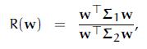
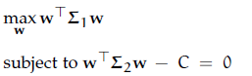
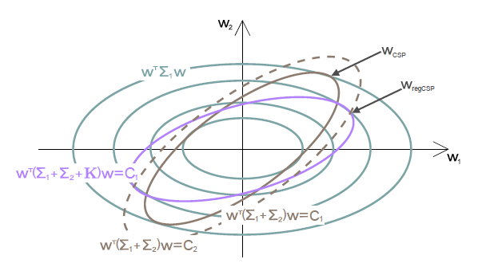
Methods (2/3)
Common Spatial Pattern (CSP)
Mathematical procedure used in signal processing for separating a multivariate signal into additive subcomponents which have maximum differences in variance between two windows
Geometrical interpretation of the optimization CSP framework [Samek, 2014]

Slide 8
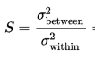
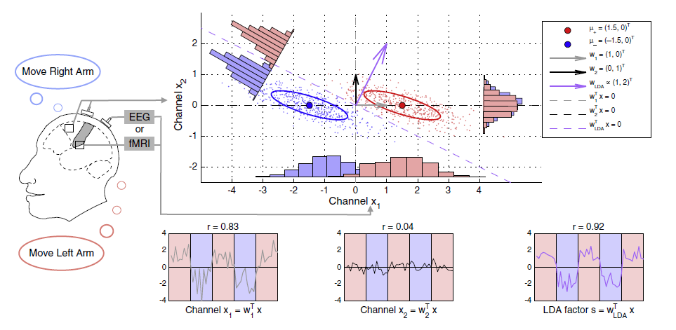
Methods (3/3)
Linear Discriminant Analysis (LDA)
A method used in statistics, pattern recognition and machine learning. to find a linear combination of features that characterizes or separates two or more classes of objects or events
Two-dimensional example of a binary classification setting [S. Haufe et al., 2014]

Slide 9
Results
Log-variance feature accuracy based on LDA
 | Log-var / LDA (10 fold) / 10 iter |  |  | C3/Cz/C4
 | 7-13Hz | 8-30Hz | 1-100Hz
1 | 0.72 | 0.69 | 0.63
2 | 0.59 | 0.61 | 0.57
3 | 0.56 | 0.55 | 0.54
4 | 0.89 | 0.89 | 0.85
5 | 0.66 | 0.75 | 0.63
6 | 0.67 | 0.72 | 0.61
7 | 0.60 | 0.67 | 0.59
8 | 0.69 | 0.69 | 0.67
9 | 0.70 | 0.73 | 0.70
Mean | 0.68 | 0.70 | 0.64
1. Log-variance features and LDA
It showed a 70% average accuracy
Subject 4 showed a good result, but subject 3 had a bad result
It showed different average accuracies with different frequency information
2. CSP features and LDA
It showed a 70% average accuracy
It showed a similar result with above result for each person
It indicated the CSP features and log variance features are giving similar results in this dataset
CSP feature accuracy based on LDA
 | CSP / LDA (10 fold) / 10 iter |  |  | C3/Cz/C4
 | 7-13Hz | 8-30Hz | 1-100Hz
1 | 0.75 | 0.73 | 0.65
2 | 0.59 | 0.58 | 0.58
3 | 0.54 | 0.52 | 0.54
4 | 0.89 | 0.89 | 0.85
5 | 0.68 | 0.74 | 0.68
6 | 0.68 | 0.71 | 0.61
7 | 0.67 | 0.73 | 0.58
8 | 0.72 | 0.68 | 0.67
9 | 0.71 | 0.76 | 0.72
Mean | 0.69 | 0.70 | 0.65

Slide 10
Discussion
Log-variance - LDA
CSP - LDA
1. Feature distribution
Intuitively, subject 4 showed a well-distributed distribution for classification
But, subject 3 showed a not suitable distribution for classification
2. Log-variance vs CSP
It does not look like a huge difference between them
Subject 4
Subject 3
Feature distribution of data samples

Slide 11
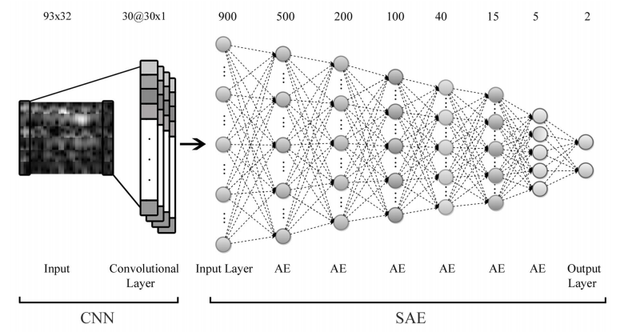
Deep learning in BCI
Related works
In the BCI literature, Deep learning is being used little by little in nowadays
According to [Y.R. Tabar, 2017], they show high performance MI task using deep learning method
[Y.R. Tabar, 2017]

Slide 12
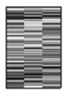
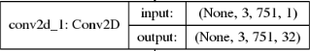
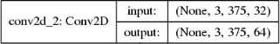
Proposed Model
Input : time domain BCI dataset (without FFT)
[Y.R. Tabar, 2017] uses Short Time Fourier Transform (STFT)
Our method is more simple without loss of accuracy
Model : 7 Convolutional layer
With Batch-normalization, max-pooling (1x2)
FC
Cov1
Cov2
Cov3
Cov4
Cov5
Cov6
Cov7
Conv1
Conv2
Raw input
Proposed model
Example of layers

Slide 13
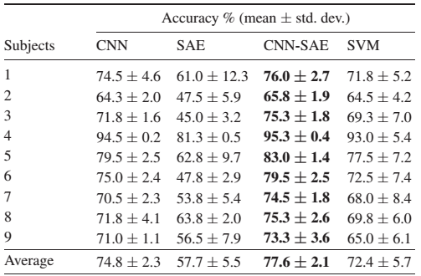
Results
CNN model accuracy
 | CNN 7 layer / 10 iter |  |  | C3/Cz/C4
Subjects | 7-13Hz | 8-30Hz | 1-100Hz
1 | 0.75 | 0.70 | 0.65
2 | 0.52 | 0.56 | 0.45
3 | 0.50 | 0.47 | 0.50
4 | 0.95 | 0.95 | 0.95
5 | 0.73 | 0.83 | 0.82
6 | 0.62 | 0.65 | 0.60
7 | 0.73 | 0.80 | 0.80
8 | 0.85 | 0.78 | 0.88
9 | 0.83 | 0.87 | 0.85
Average | 0.72 | 0.74 | 0.72
Ablation study
1 layer : decreasing accuracy of 2%
BatchNorm : increasing training speed
It showed a 74% average accuracy among subjects
It showed a similar results compared to the conventional method (aforementioned results)
Our model’s accuracy is similar to accuracy of CNN with STFT of [Y.R. Tabar, 2017]
Our model
[Y.R. Tabar, 2017]

Slide 14
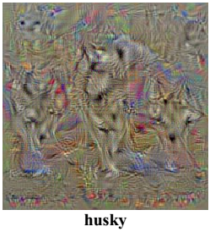
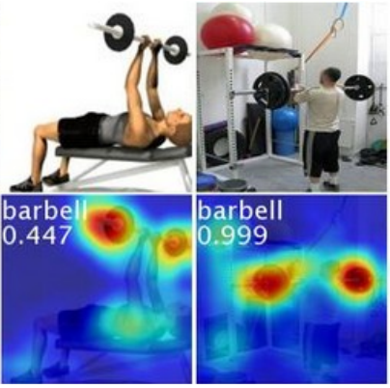
Discussion
To interpret the BCI classification results, we use two CNN layer visualization methods
1. Class Model Visualisation (a.k.a. saliency)
Deep Inside Convolutional Networks: Visualising Image Classification Models and Saliency Maps [K. Simonyan, 2014]
2. Class Activation Map
Learning Deep Features for Discriminative Localization [B. Zhou 2015]

Slide 15
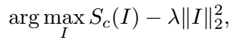
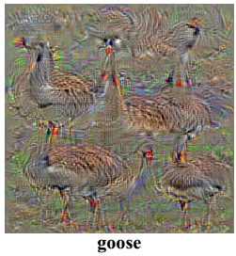
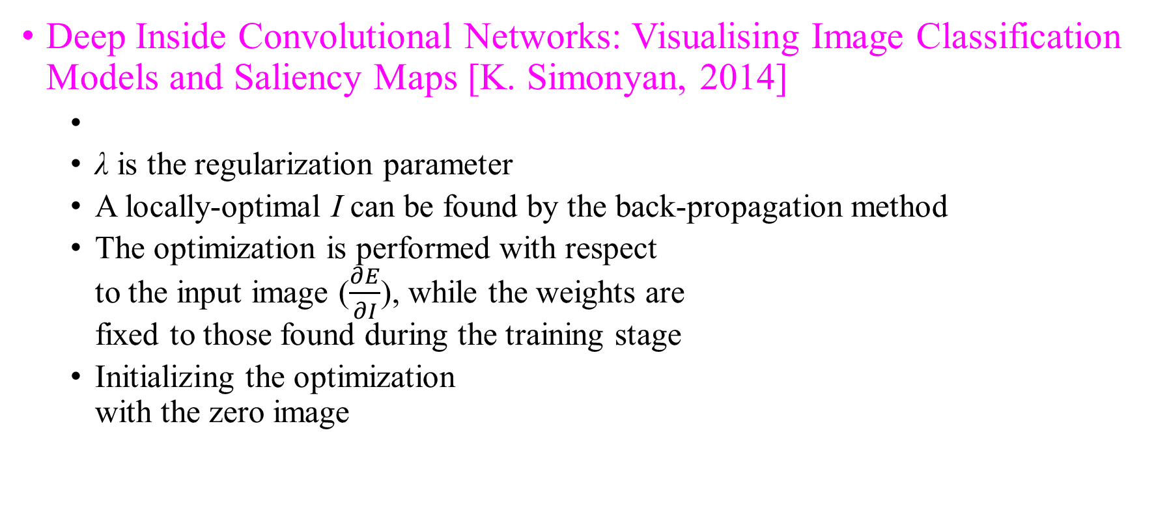
Visualization – Class Model Visualisation
Deep Inside Convolutional Networks: Visualising Image Classification Models and Saliency Maps [K. Simonyan, 2014]
λ is the regularization parameter
A locally-optimal I can be found by the back-propagation method
The optimization is performed with respect to the input image ($\frac{∂E}{∂I}$), while the weights are fixed to those found during the training stage
Initializing the optimization with the zero image

Slide 16
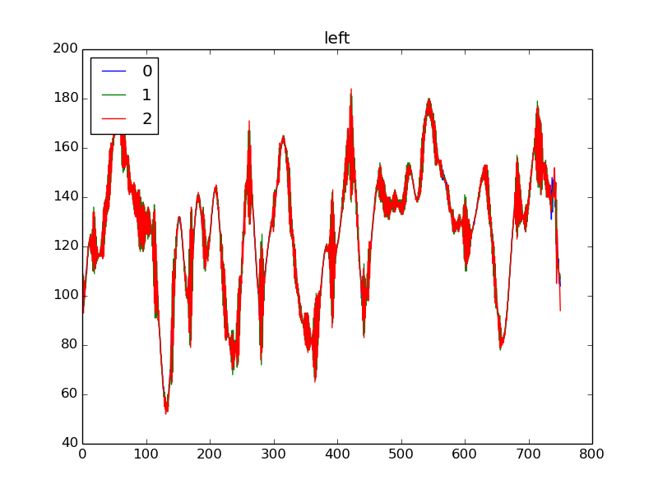
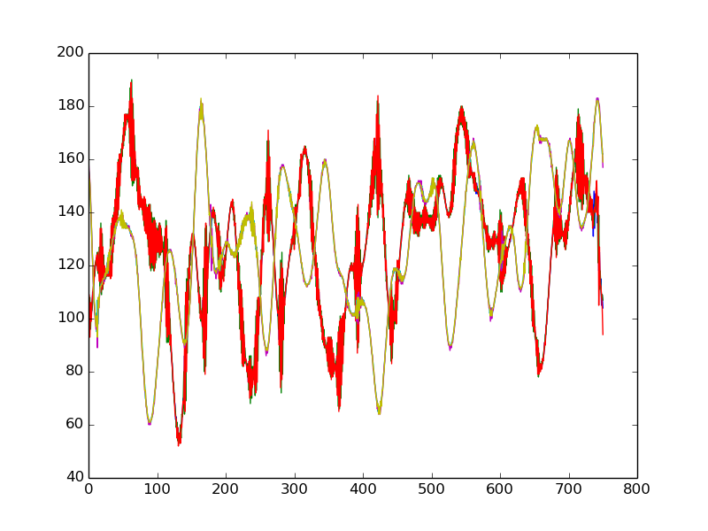
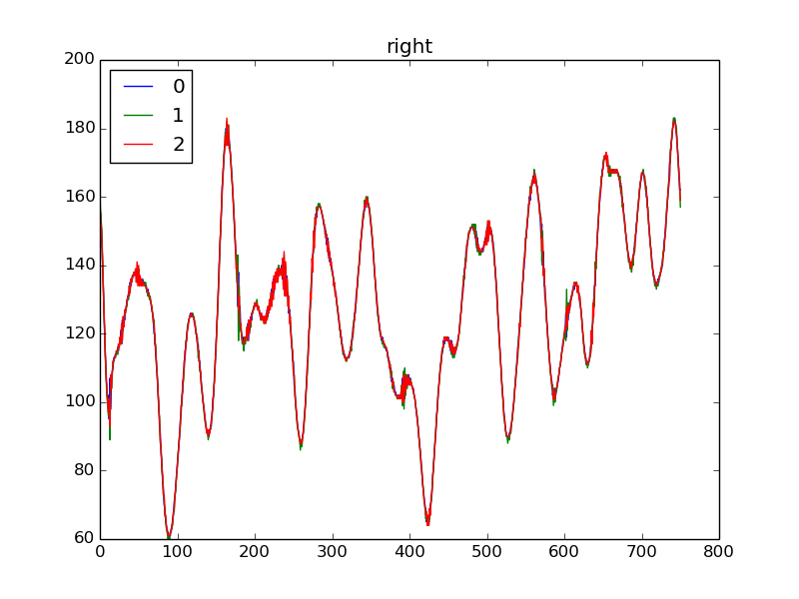
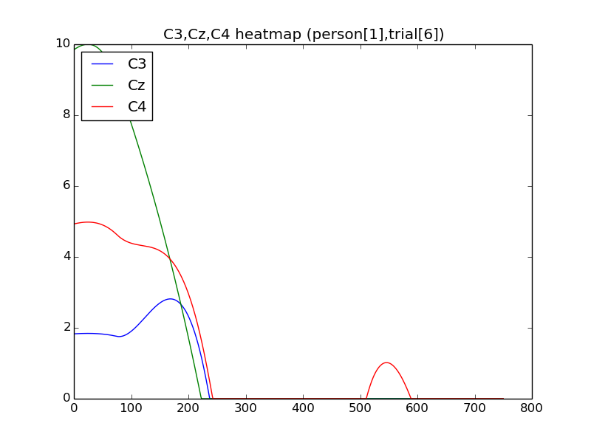
Visualization – Class Model Visualisation (Cont’d)
Ideally, left class pattern shows that C4 pattern is higher than C3 and vice versa
Showing that 3 channels are coupled together
Further research is needed to ensure that the model decouples 3 channels
Right class pattern
Combination of left, right classes pattern graphs
Left class pattern

Slide 17
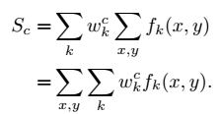
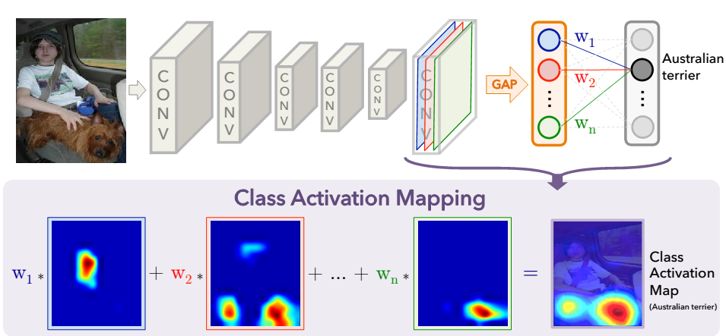
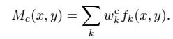
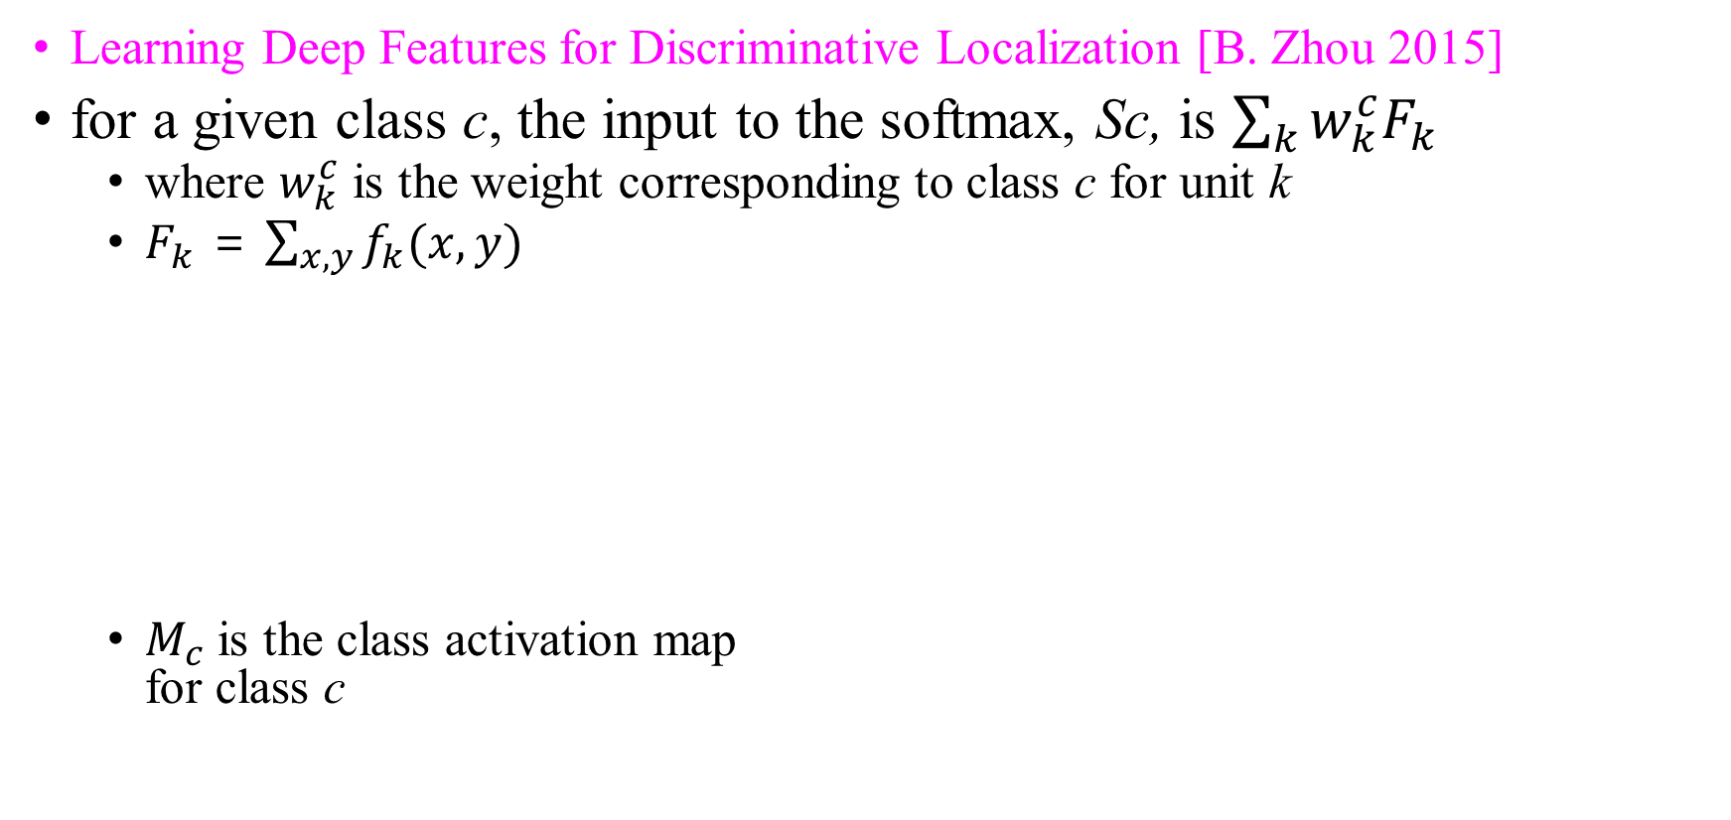
Visualization – Class Activation Map
Learning Deep Features for Discriminative Localization [B. Zhou 2015]
for a given class c, the input to the softmax, Sc, is $\sum_{k}{w_{k}^{c}F_{k}}$
where $w_{k}^{c}$ is the weight corresponding to class c for unit k
$F_{k}$ = $\sum_{x,y}{f_{k}(x,y)}$
$M_{c}$ is the class activation map for class c

Slide 18
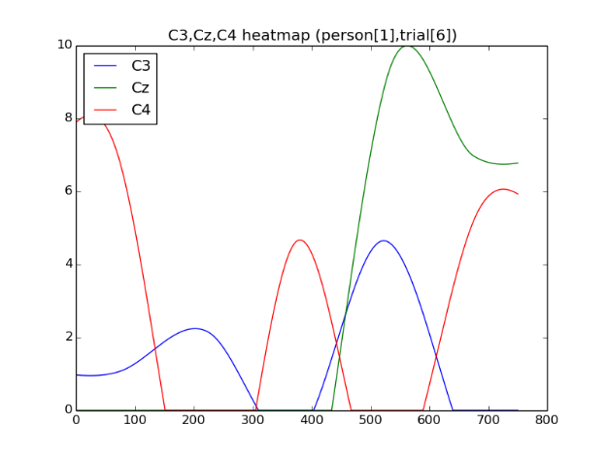
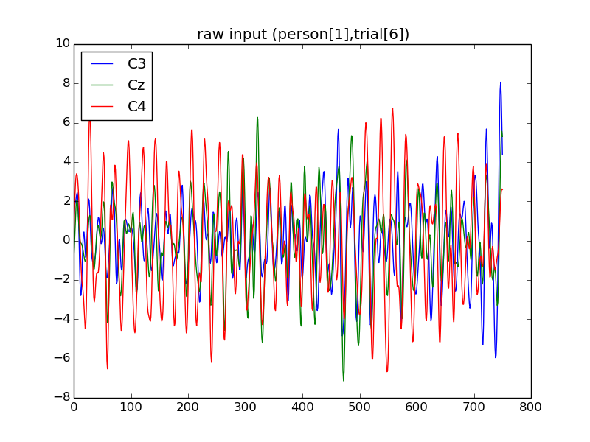
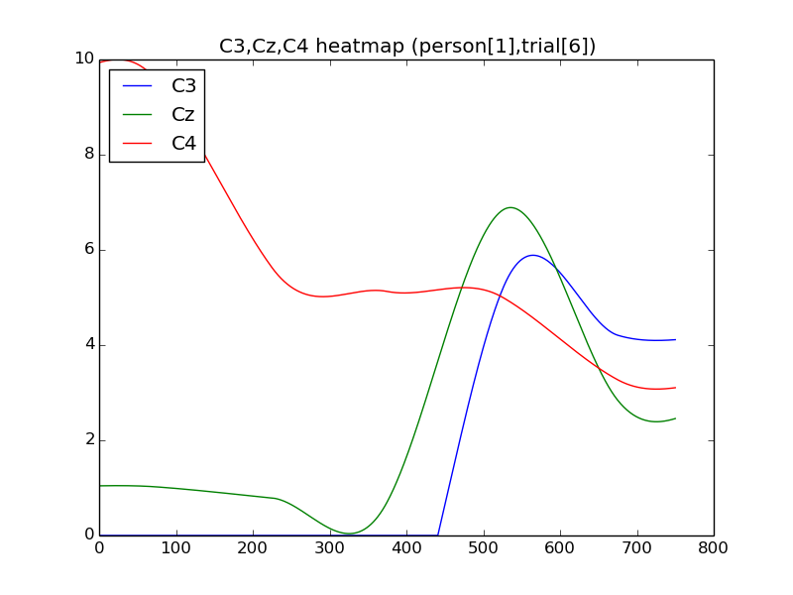
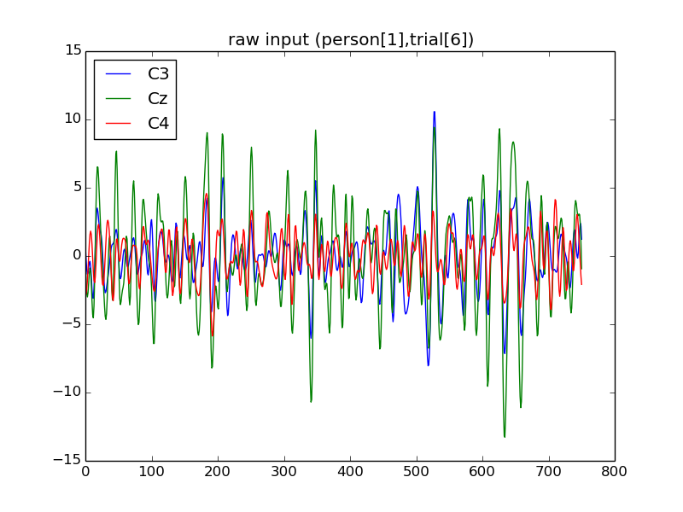
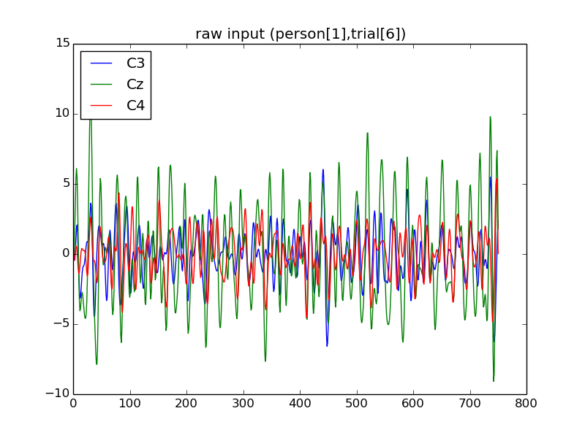
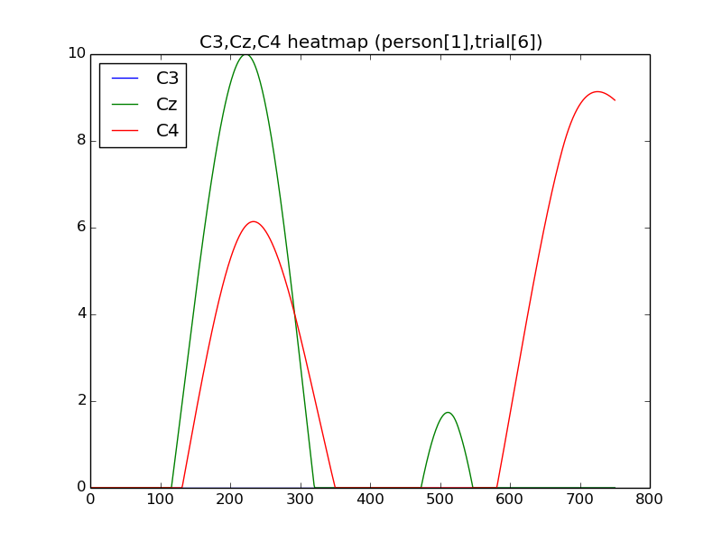
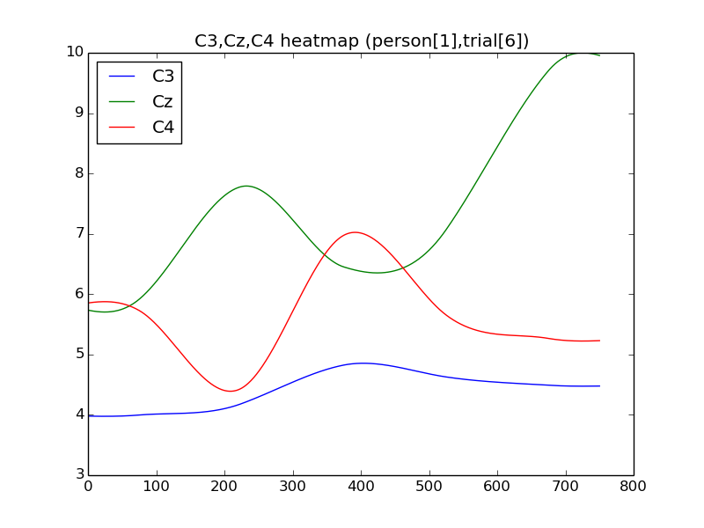
Visualization – Class Activation Map (Cont’d)
Comparison between person 4(accuracy=0.95) and person 3(accuracy=0.5)
person 3(accuracy=0.5) shows complex and multi-modal graph
person 4(accuracy=0.95) shows simple and unimodal graph
person 3 – raw input (right class)
person 3 – CAM (right class)
person 4 – raw input (right class)
person 4 – CAM (right class)
person 3 – raw input (left class)
person 3 – CAM (left class)
person 4 – raw input (left class)
person 4 – CAM (left class)

Slide 19
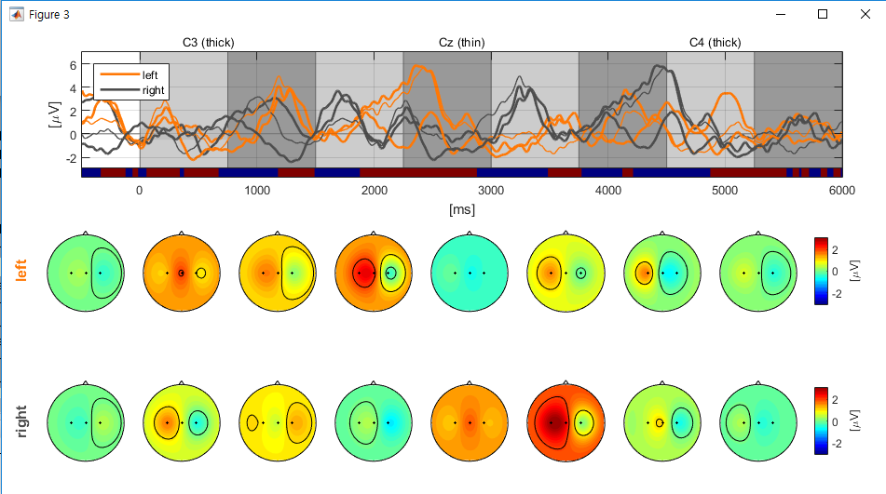

Visualization – Class Activation Map (Cont’d)
Comparing Class Activation Map with Time-amplitude topoplot
At the 2/3 area of CAM (right class) C3 activation value is sharply increased
At the 6th topoplot C3 activation value is sharply increased
We can conjecture that our model classify in terms of which channel shows high amplitude
person 4 (trial 127) – CAM (right class)
person 4 (trial 127) – CAM (left class)
Time-amplitude topoplot for subject 4 (trial 127)

Slide 20
Conclusion
Results
Conventional way : accuracy is 70%
Deep learning way : accuracy is 74%
Contribution
Comparing conventional method and deep learning method
Identifying our model’s drawback through CNN visualization method
Trying to explain deep learning model in the BCI process, which is not fully covered yet in the BCI literature
We can research further thanks to this project

